Slide 1

Rockbuster Stealth llc. SALES Analysis
Presented by : Elif Akkas
December 22, 2021

Slide 2








Company Overview
Rocbuster Stealth LLC is a movie rental company that used to have stores around the world.
Facing strong competition from streaming services such as Netflix, Amazon
In order to stay competitive, Rockbuster Stealth LLC company is planning to launching an online video rental service.

Slide 3




Rental Overview
Rental Rates
*Min: $0.99
*Max: $4.99
*Avg: $2.98
Replacement Cost
*Min: $9.99
*Max: $29.99
*Avg: $19.98
Rental Duration
*Min: 3 Days
*Max: 7 Days
*Avg: 5 Days
Film Duration
*Min: 46 minutes
*Max: 185 minutes
*Avg: 115 minutes

Slide 4


Which Movies Contributed the Most & Least to Revenue Gain?

Slide 5

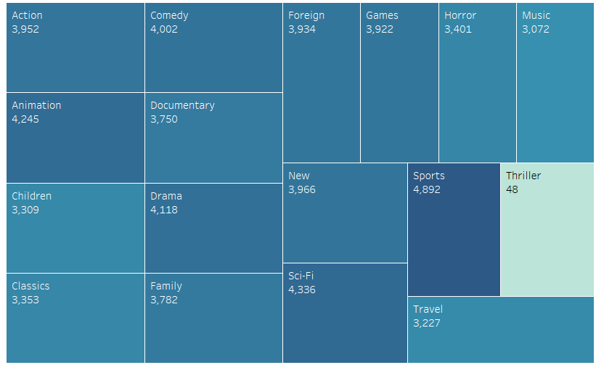
Revenue by Genre
Largest gross revenue comes from Sports, Animation, Comedy, Sci-fi.
The least gross revenue comes from Thriller, Music, Children movies.

Slide 6
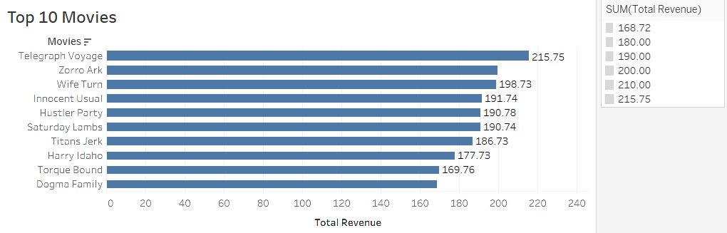
Top Ten Movies

Slide 7
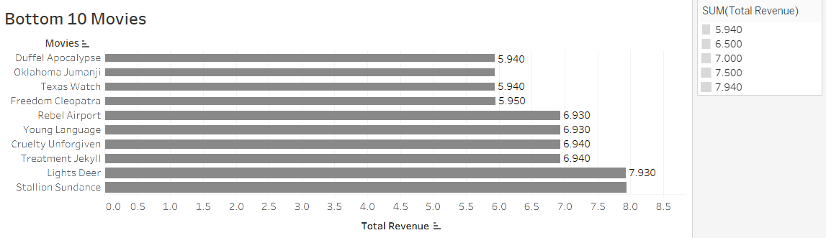
Bottom Ten Movies

Slide 8
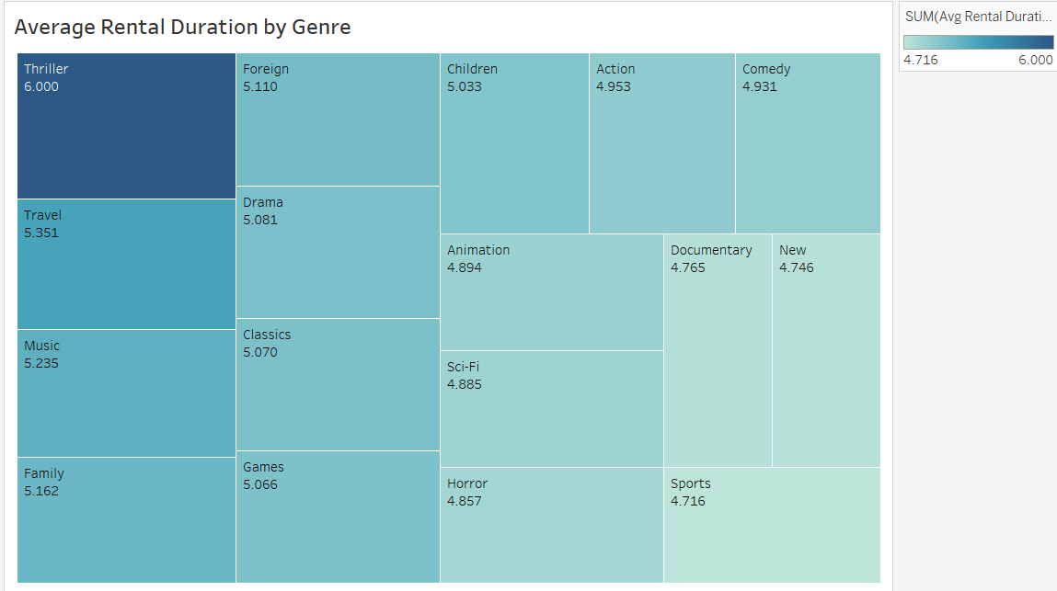
Average Rental Duration by Genre

Slide 9

Which Countries Are Rockbuster Customers Based In?

Slide 10
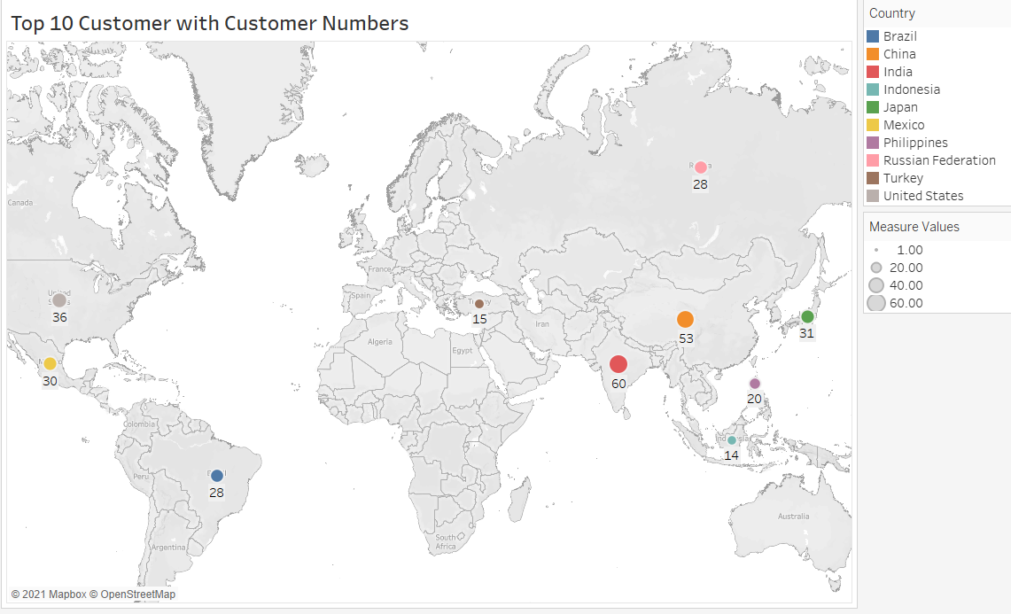
Top 10 Countries with Customer Numbers

Slide 11

Where are top 5 customer?

Slide 12
